Slide 1

CyberLabs
01

Slide 2

Topics we will discuss
About Us
Introduction
CyberLabs Frontend Tech Stack
Back-End Part
Cyber Security Labs
Supervisor: Dr. Marwa Sharaf Eldin
02

Slide 3

  WannaCry Ransomware
    (2017)
Ransomware + worm
Over 200,000 infected machines
Over 150 countries affected
Estimated $4–8 billion
02

Slide 4


Problem Statement
CyberLabs is an educational cybersecurity platform designed to bridge the gap between theoretical knowledge and practical skills.
It offers structured, easy-to-understand theoretical content along side hands-on lab exercises that simulate real-world cybersecurity scenarios.
The platform is tailored for students, trainees, and beginners who seek to develop a solid foundation in cybersecurity by applying what they learn in an interactive and guided environment.
04

Slide 5
CyberLabs
01

Slide 6
Who is target from the project?
The Cyber Lab platform is specifically designed for:
University students studying cybersecurity, computer science
Fresh graduates looking to build hands-on experience in cybersecurity.
Beginners and self-learners who want to understand both the theory and practice of cybersecurity in a simplified and structured way.
Trainees in internship or training programs who need guided lab exercises to apply their knowledge.
Technical instructors and training centers looking for ready-to-use theoretical content and practical labs to support their teaching.
05

Slide 7
WORK FLOW
05

Slide 8






About-Us
Eng. Ahmed Hussien
Eng. Ahmed G Sherif
Eng. Ebrahim Gamal
Eng. Moamen Mostafa
Role. FullStack Dev
Role. Front-End Dev
Role. Front-End Dev
Role. Back-End Dev
Eng. Ebrahim M Nassar
Eng. Mohamed Emad
Eng. Ahmed Radwan
Role. Cyber Security
Role. Cyber Security
Role. Cyber Security
03

Slide 9


CyberLabs Frontend Tech Stack
Frontend Frameworks
React 18 with JSX and Hooks​
React Router v6 for client‑side navigation and route guards
Nested Routes & Route Guards with React Router v6
Protected Pages: <RequireAuth> wrapper
05

Slide 10


Cont... :
Styling & UI Libraries
Bootstrap grid & utilities
Ant Design components
Emotion (CSS‑in‑JS) for dynamic, theme‑aware styles
Custom CSS for overrides & responsive tweaks
05

Slide 11
Cont... :
Performance & Optimization
Code Splitting & Tree Shaking
Lazy Loading via React.lazy() + <Suspense>
Service Workers for offline caching
WCAG 2.1 AA compliance: high‑contrast themes, keyboard nav
05

Slide 12


Cont... :
Icons & Animations
React Icons, Font Awesome, Bootstrap Icons
AOS (Animate On Scroll) & Swiper for engaging motion
05

Slide 13

Cont... :
State Management
Local State: useState, useReducer for UI logic
Global State: Context API (AuthContext, ThemeContext)
Custom Hooks: useFetch(), useAuth(), useTheme()
06

Slide 14
Cont... :
Core UI Components
Form Controls & Inputs
Reusable <Button>, <Input>, Ant Design <Form>
Content Display
<CourseCard> and Ant Design <List> with pagination
Responsive grid layouts for card collections
Feedback & Modals
SweetAlert2 for confirmation & prompts​
React Toastify for in‑app notifications
Navigation & Icons
Icon buttons via React Icons/Font Awesome​
“Back to Top” and Theme Switcher components
06

Slide 15
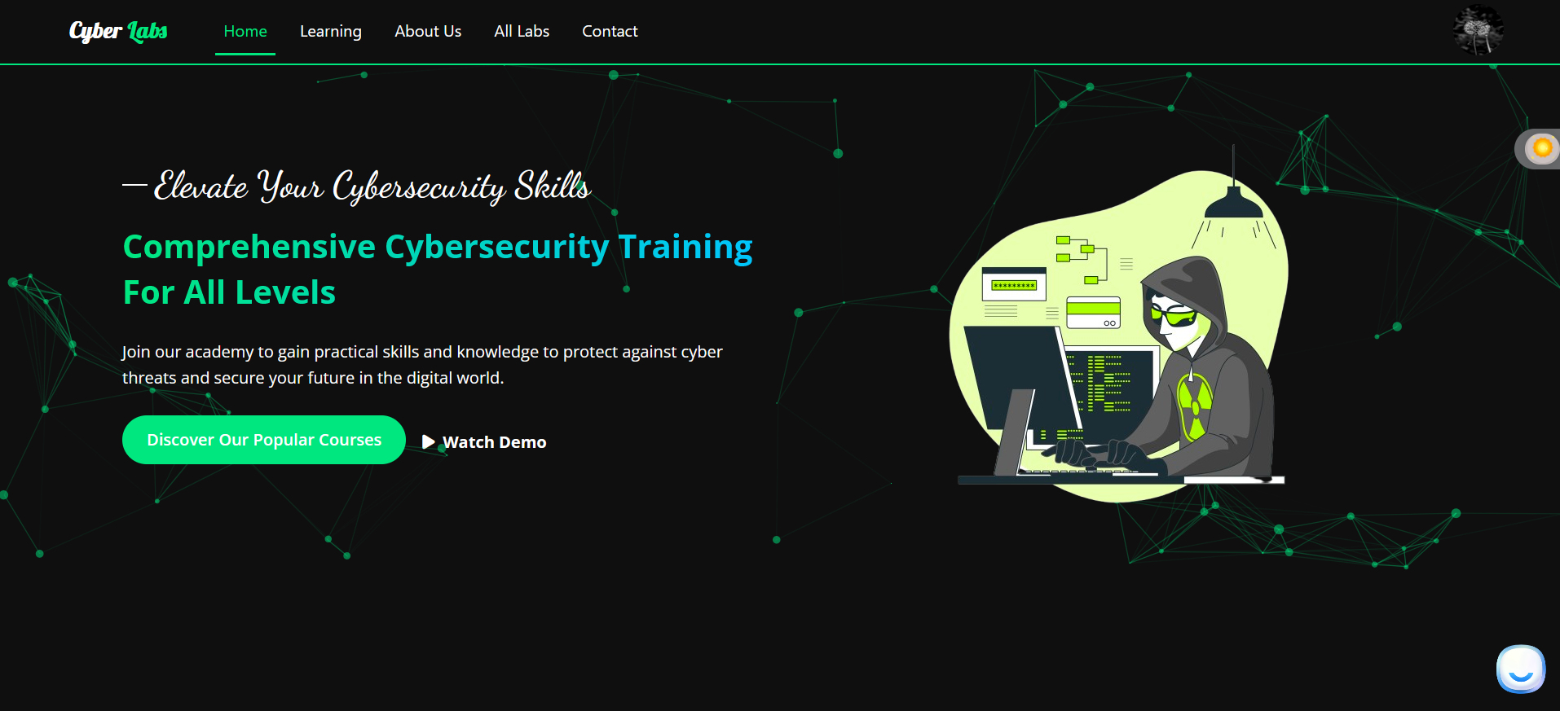
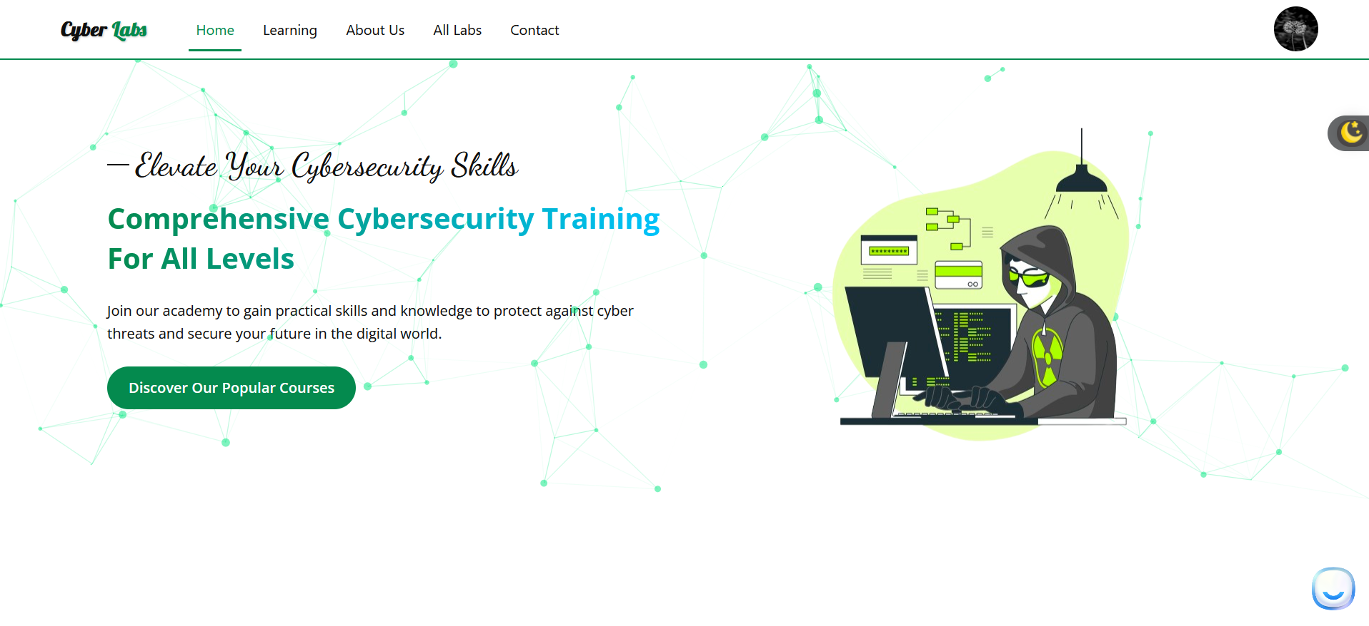
Platform Demo :
Theming
08

Slide 16
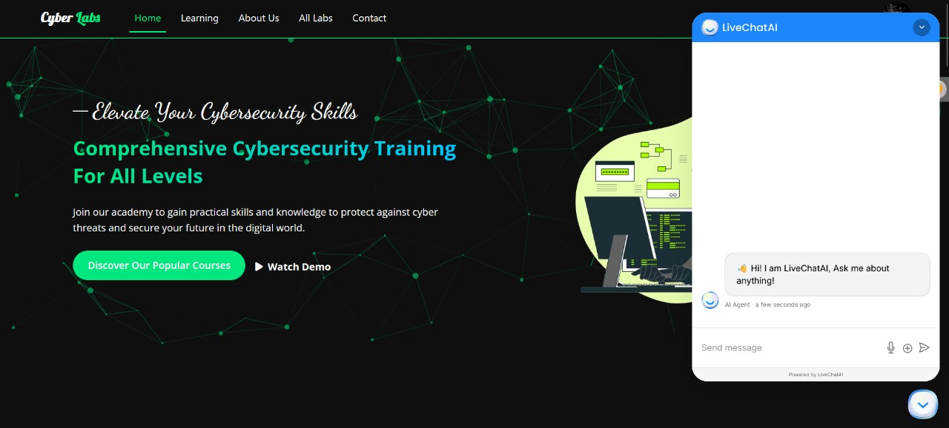
Cont.....:
Live AI‑Powered Chatbot
“Instant student support”
Natural‑language interface for course Q&A​
Guides learners through navigation and troubleshooting​
Reduces instructor load & improves engagement
09

Slide 17
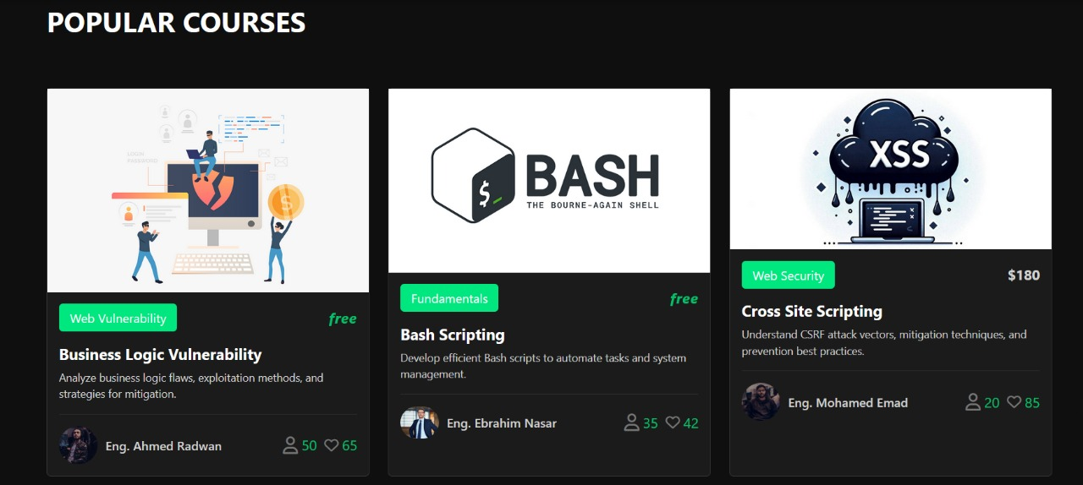
Cont.....:
“Highlighting our mostin‑demand content”
Popular Courses Showcas
Dynamically ranks courses by enrollment & rating
Eye‑catching thumbnails and brief descriptions
Encourages learners to explore top offerings
10

Slide 18
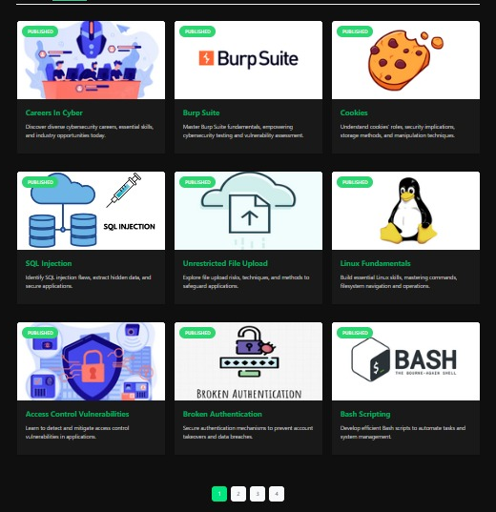
Cont.....:
Course Catalog View
“Browse and filter all available courses”
Clean grid layout with course title, instructor, and price
Filter by category, difficulty, or popularity
Quick “Learn More” links for detailed syllabus
11

Slide 19
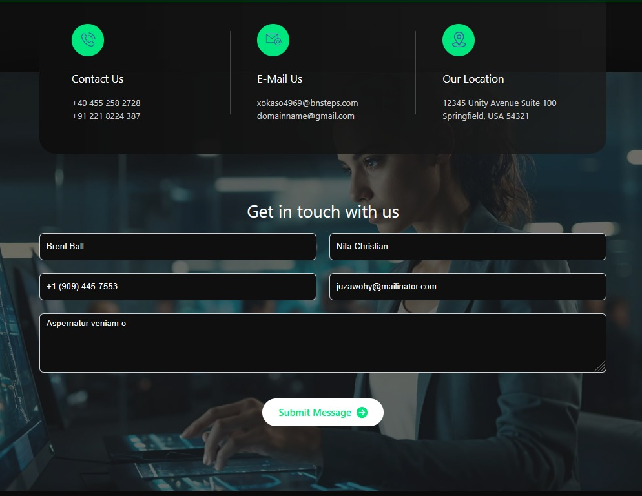
Cont.....:
Contact Us Page View
“ Get in touch with our team”
Simple form for questions, feedback, or support requests
Integrated map & contact details for in‑person visits
Social‑media icons for alternative channels
12

Slide 20
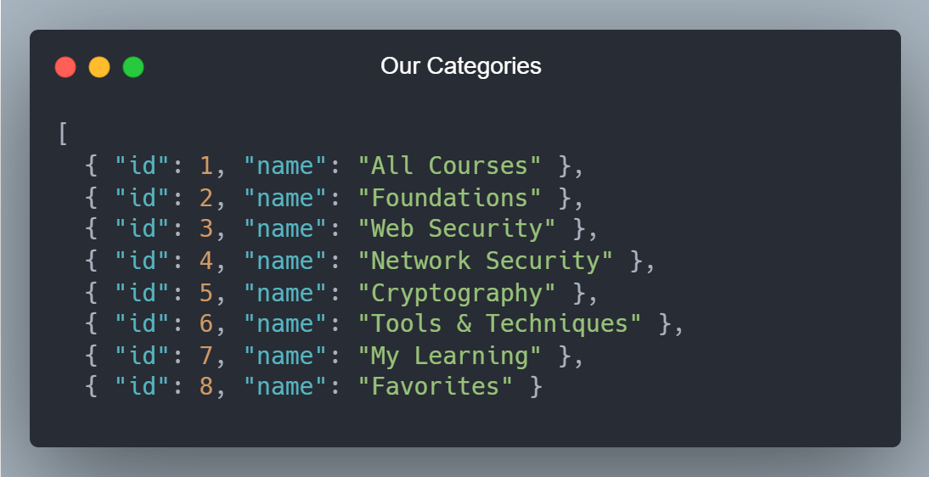
Cont.....:
Course Categories
“Navigate our platform by topic”
All Courses – Browse every course we offer in one place.
Fundamentals – Master the core concepts you need before diving deeper.
Vulnerabilities – Learn about common security weaknesses and how to exploit/patch them.
Tools & Techniques – Get hands‑on with the industry’s most popular pentesting toolset.
My Courses – Quickly access the classes you’re currently enrolled in.
Fav Topics – Save and revisit your favorite subjects with a single click.
13

Slide 21

Backend technologies:
1- Why Node.js?
Node.js is a fast and scalable JavaScript runtime built on Chrome’s V8 engine, designed for server-side development using an event-driven, non-blocking model. It excels in API-based applications.
14

Slide 22

2- Why using TS instead of JS
1:Type Safety: TypeScript adds static typing, which helps catch errors during development rather than at runtime.
2: Scalability and Maintainability: TypeScript enforces cleaner, more structured code, which is crucial for scaling applications.
15

Slide 23

3- PostgreSQL
PostgreSQL is a powerful, open-source relational database known for its
ACID-compliance
1- Atomicity 3- Isolation
2- Consistency 4- Durability
It is known also by its reliability, scalability, and support for complex queries, making it ideal for managing structured data.
16

Slide 24

4- Prisma
Prisma ORM complements PostgreSQL by providing a type-safe, developer-friendly interface that simplifies database operations, enhances performance, and reduces runtime errors.
17

Slide 25
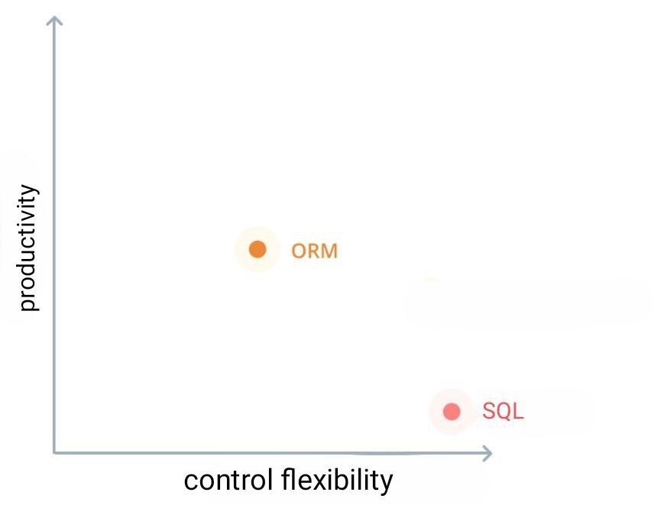
cont..
Why using ORM (Object-Relation Mapping)
1) Boosts Productivity
2) Reduce runtime errors
18

Slide 26

5- Docker and containerization
Docker: is an open-source platform that uses containerization to package applications and their dependencies into isolated, portable environments, ensuring consistency across different environment.
It improves portability, scalability, and resource efficiency, and simplifies deployment and management. This makes it ideal for modern development workflows, especially in projects requiring quick setup and reliable performance.
19

Slide 27
6- Express
Express.js is a minimalist and efficient web framework for Node.js that simplifies building server-side applications by providing built-in support for routing, middleware, and RESTful APIs.
Express.js is a minimalist and efficient web framework for Node.js that simplifies building server-side applications by providing built-in support for routing, middleware, and RESTful APIs.
20

Slide 28

7- RESTful API
RESTful APIs are a standardized way of building web services using HTTP methods (GET, POST, PUT, PATCH, DELETE) to perform operations on resources identified by URLs.
21

Slide 29

Lab Title: Top Secret
Objective: Investigate a corrupted image file and uncover a hidden multi-layered message using digital forensics techniques.
Scenario :
Ali found a USB labeled "Top Secret" containing a file: lost_image.jpg The image fails to open appearing corrupted Ali suspects hidden data is embedded.
Your mission: Analyze and extract the hidden message.
Step 1: Analyze the File Header
Open the file in a hex editor.
Inspect the first 8 bytes (magic number / file signature).
22

Slide 30
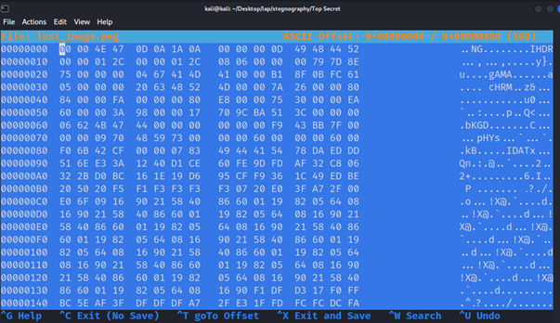
Cont.....:
23

Slide 31
Cont.....:
Found header: 00 00 4E 47 ... → Invalid
Expected PNG header: 89 50 4E 47 0D 0A 1A 0A
Step 2: Fix the File Signature
manually modify the first 8 bytes to match the valid png signature using hex editor.
From: 00 00 4E 47 ... To: 89 50 4E 47 0D 0A 1A 0A
Save the changes.
24

Slide 32

Cont.....:
Step 3: View the Image
After fixing, the image opens successfully It contains a QR code.
Step 4: Scan the QR Code
Use any QR scanner.
The QR reveals a Morse code message.
25

Slide 33
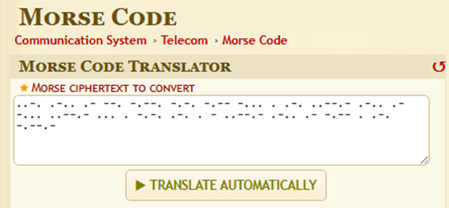
Cont.....:
Step 5: Decode the Morse Code
Paste the Morse string into an online decoder.
The output reveals the hidden Flag : FLAG(CYBER_LAB_SECRET_LAYER)
26

Slide 34
Conclusion :
This lab simulates a real-world digital forensics case involving :
File header manipulation
Signature verification
QR code analysis
Morse code decoding
It teaches how a small change (like corrupted file headers) can hide or break access to valuable data, and how layered obfuscation can be used both for legitimate and malicious purposes.
27

Slide 35
SQL Injection
What is SQL Injection :
An injection attack that allows an attacker to interfere with the queries an application makes to its database.
​
Why is it dangerous :
It can allow:
Authentication bypass​
Data leakage​
Full system compromise
​
SQL-Injection Labs :
vulnerability allowing login bypass
28

Slide 36
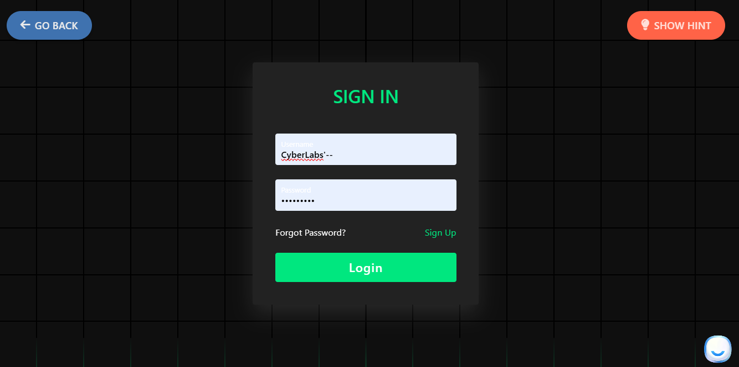
Lab1: vulnerability allowing login bypass
Objective: Exploit a SQL injection vulnerability in the login form to log in as the administrator withoutknowing the password.
Step 1:Go to Login Page: Click the Login button or link to reach the login form.​
Step 2: Enter Payload: In the username field, enter:​
CyberLabs’--
Leave the password field blank or enter any text.​
​
29

Slide 37
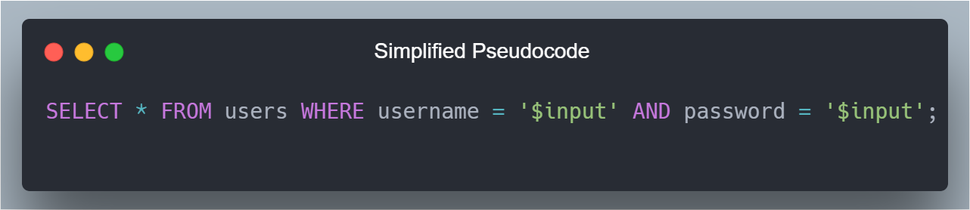
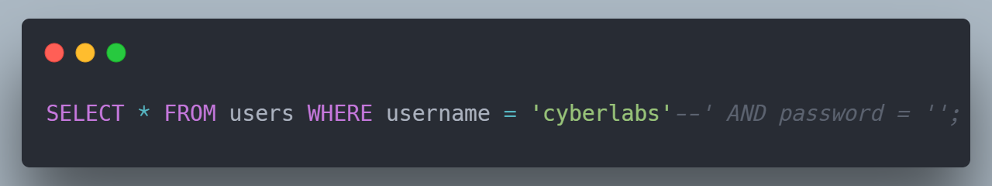
Explanation:
' closes the existing query string.​
OR 1=1 makes the condition always true.​
-- comments out the rest of the SQL query (password check).
What Happens Internally
The query likely looks like:
After injection:
30

Slide 38
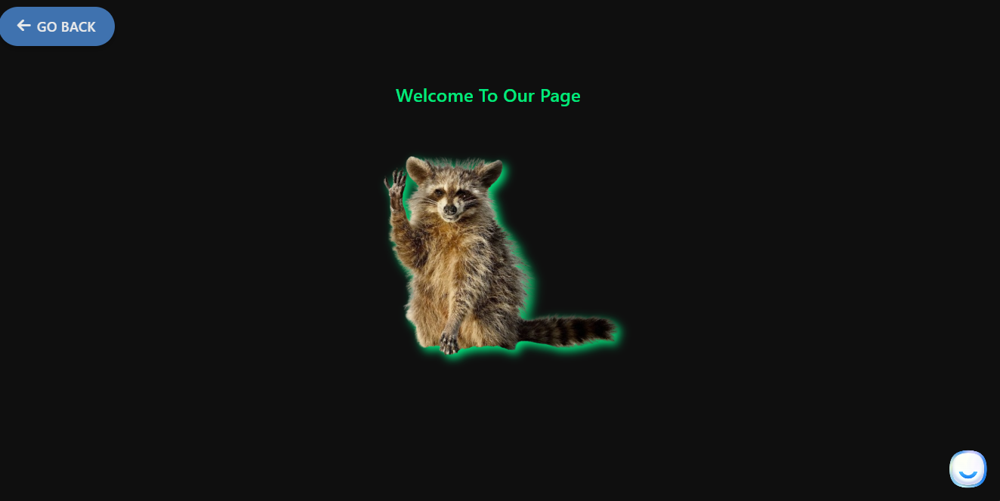
Step 3: Submit the Form: Click Login. The injected payload will bypass authentication, logging youin successfully.
View Success Flag: You should see the “Welcome To Our Page” message indicating the lab is solved.
31

Slide 39
Why This Happens
The application fails to sanitize or parameterize the input before using it in SQL queries.​
User input is directly injected into SQL logic = vulnerability.
How to Prevent It​​
Use Prepared Statements (ex: PDO or mysqli with bind_param)​​
Apply input validation and sanitization​​
Implement least privilege on the database​​
Use Web Application Firewalls (WAFs) to block known attack patterns​​
32

Slide 40
Lab1: Race Attack: Multi-Accounts, One Email
Objective:
Learn to exploit a Race Condition vulnerability by sending multiple concurrent registration requests using the same email address, bypassing validation checks and creating multiple accounts.
​
Scenario:​
You are a penetration tester evaluating a web application that allows users to register with a unique email address. The system checks whether an email is already registered before creating a new account. However, due to a lack of proper concurrency control, it is vulnerable to a Race Condition—specifically a TOCTOU flaw (Time-of-Check to Time-of-Use). By sending several registration requests simultaneously, you can overwhelm the server and create multiple accounts using the same email address before the database finishes updating.
The lab environment includes :​
​
A vulnerable web application​​
A browser​​
Burp Suite Community Edition or any tool capable of sending parallel requests​
33

Slide 41
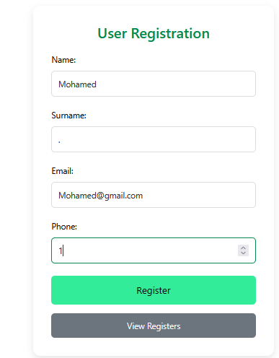
Solution Steps:
Step 1: Start Intercepting​
Enable intercept in Burp Suite.​
Begin the registration process with a valid email address.​
Step 2: Send Request to Repeater
Once the registration request is captured, send it to the Repeater.
34

Slide 42
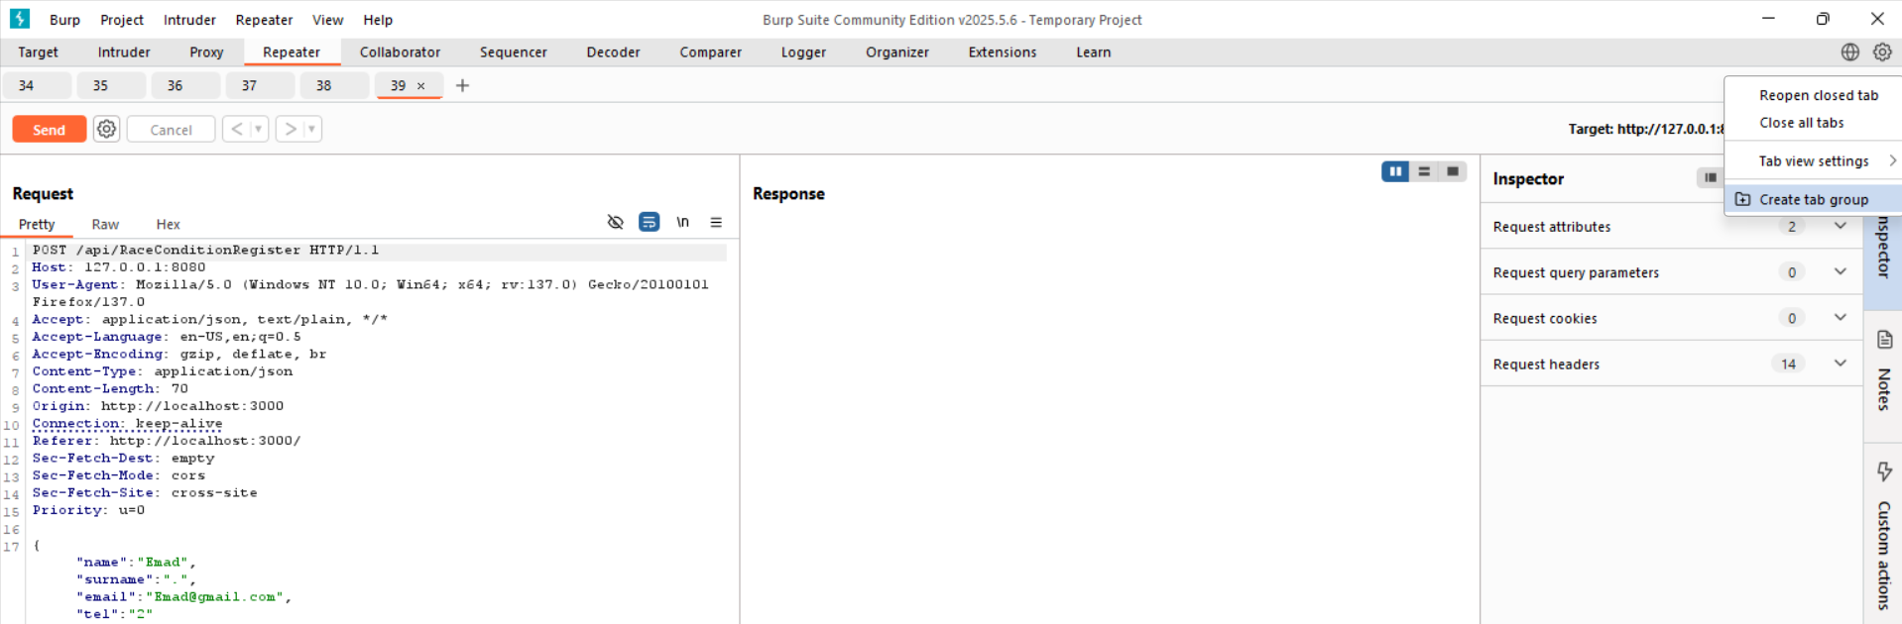
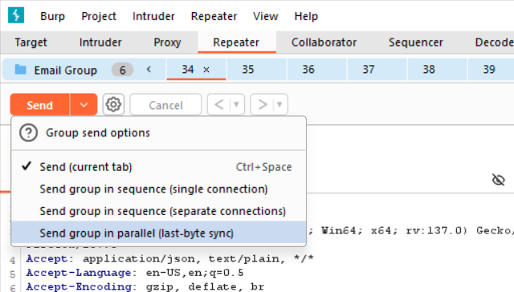
Step 3: Create a Group of Requests at Intercepting​
Repeat the request multiple times (ex: 10–20 copies).​
Use Burp’s Intruder or Turbo Intruder extension (or other tools) to prepare them
Step 4:Send Simultaneous Requests​
​
Fire the group of requests in parallel.​
35

Slide 43
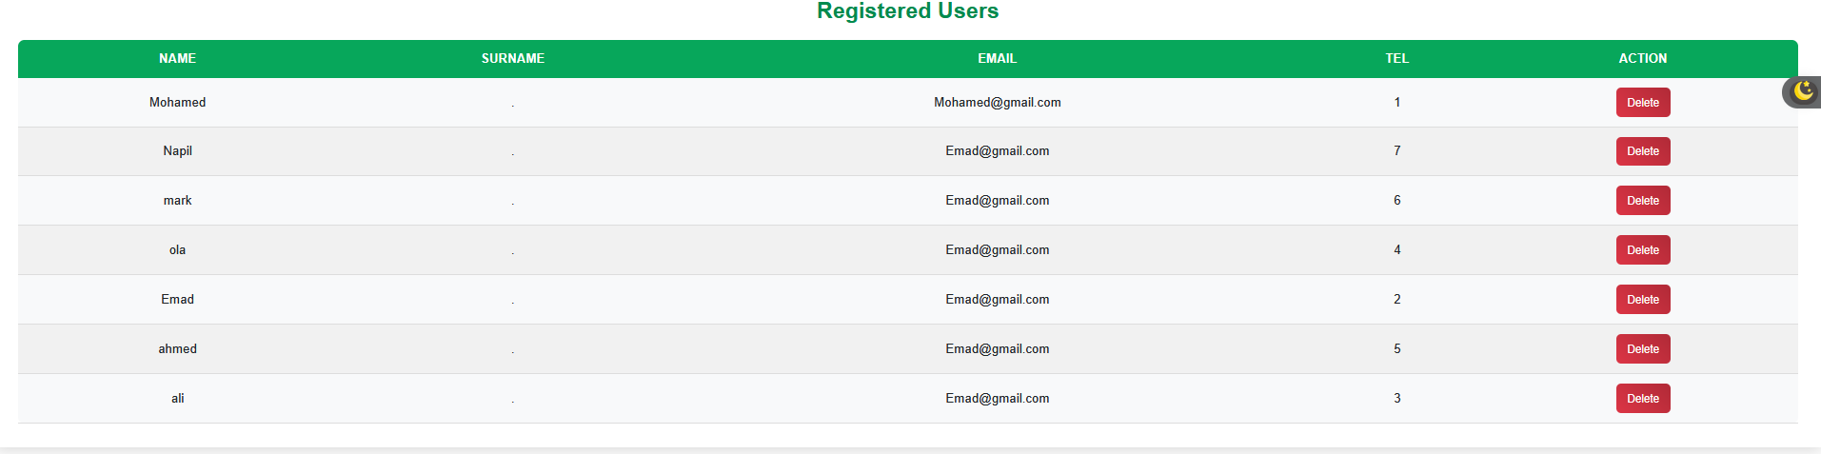
Step 5: Observe the Outcome​
​
        Check the responses or user list.​
        You will notice that multiple accounts have been successfully created with the same email address.
Expected Outcome:​
        The application fails to enforce the unique email constraint underload.​​
        Multiple accounts using the same email are created.​​
36

Slide 44
Conclusion:
This lab demonstrated how Race Condition vulnerabilities arise when a system does not handle concurrent requests safely. By sending parallel registration requests, you exploited a gap between the email check and database update, known as aTOCTOU flaw.
To mitigate this issue, developers should:
        Use atomic database operations​
        Implement locking mechanisms or mutexes​
        Validate constraints at the database level, not just in application logic
Race Conditions can lead to privilege escalation, data inconsistency, and resource abuse, and are a serious threat outlined in the OWASP Top 10.
37

Slide 45
Future work
1- Website Deployment
Launch the CyberLabs platform online to make it accessible to users.
2- Mobile Application Development:
Build a mobile version of the platform to enhance accessibility and usability on smartphones.
3- Expansion of Content:
Add more cybersecurity topics and interactive labs to cover a broader range of skills and concepts.

Slide 46
THANK YOU
38

